Slide 1
Counters
Dr. Ruba Alkhasawneh

Slide 2
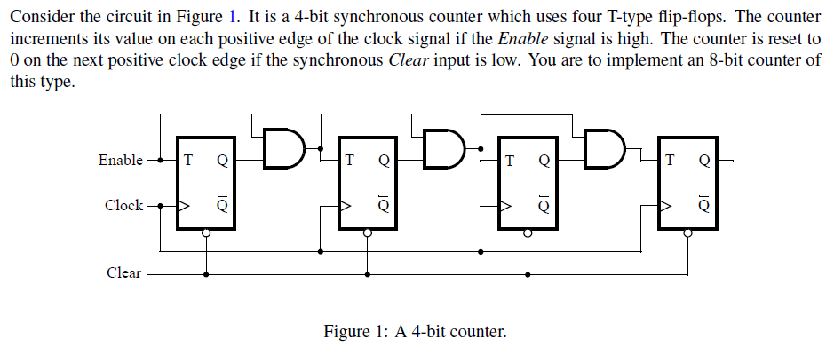
Counters

Slide 3
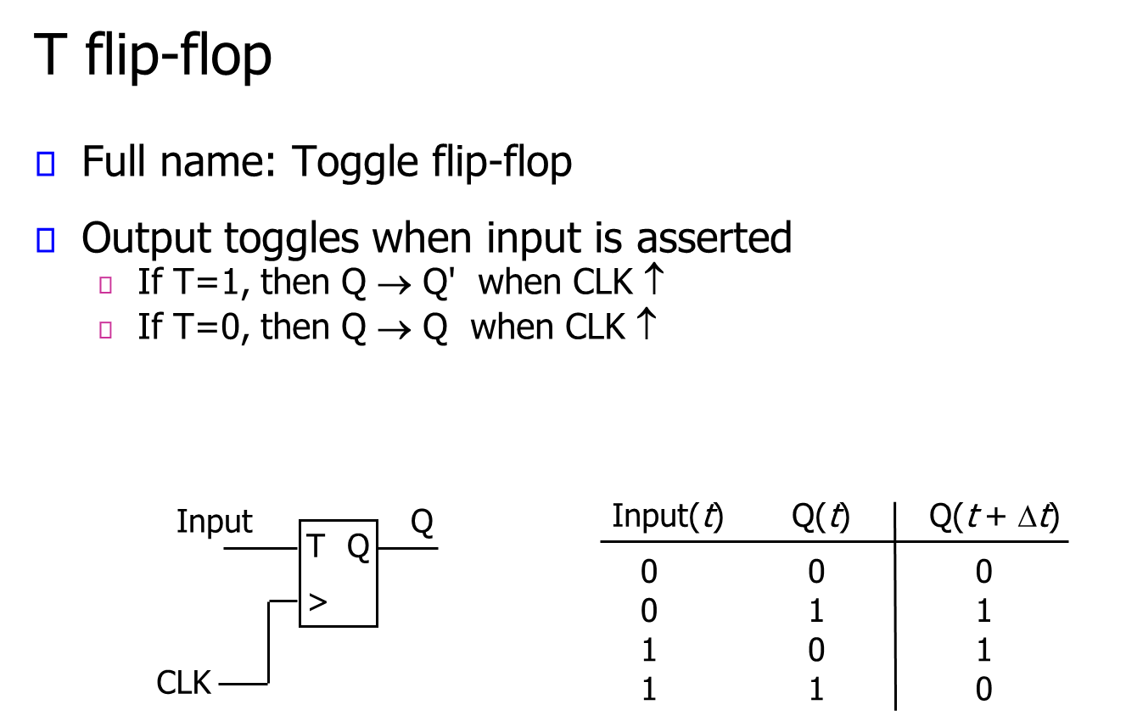

Slide 4
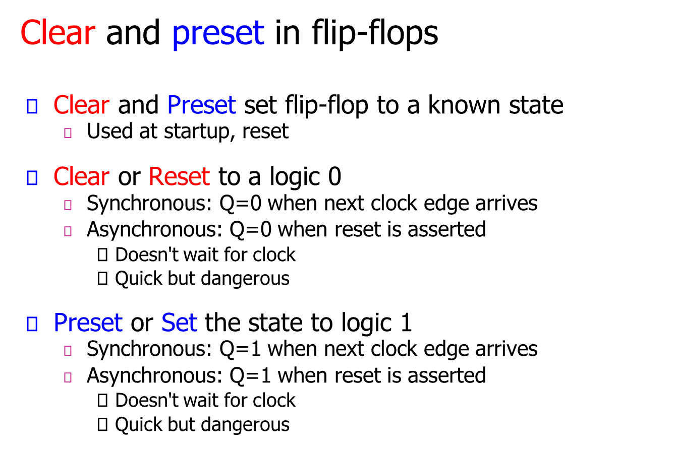

Slide 5
Implementation Steps
Write a Verilog file that defines an 8-bit counter. Your code should include a T flip-flop module that is instantiated eight times to create the counter. Compile the circuit.
How many logic elements (LEs) are used to implement your circuit?
Simulate your circuit to verify its correctness.
Augment your Verilog file to use the pushbutton KEY0 as the Clock input and switches SW1 and SW0 as Enable and Clear inputs, and 7-segment displays HEX1-0 to display the hexadecimal count as your circuit operates. Make the necessary pin assignments needed to implement the circuit on your DE-series board, and compile the circuit.
Download your circuit into the FPGA chip and test its functionality by operating the switches.

Slide 6
Quiz
In simulation, if the clock period T = 10ns. What is the clock frequency?
10MHZ
50MHZ
100MHZ
Sol:
10 ns = 1/100,000,000 (clock cycle), same as:-
1/10ns = 100,000,000 = 100MHz (clock rate).

Slide 7
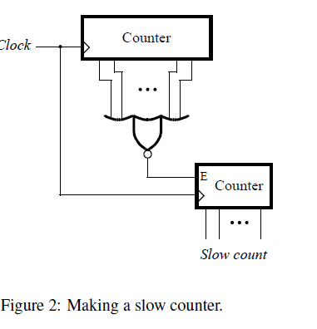
Slow Counter
Design and implement a circuit that successively flashes digits 0 through 9 on the 7-segment display HEX0.
Each digit should be displayed for about one second. Use a counter to determine the one-second intervals. The counter should be incremented by the 50-MHz clock signal provided on the DE-series boards.
Do not derive any other clock signals in your design–make sure that all flip-flops in your circuit are clocked directly by the 50-MHz clock signal.
A partial design of the required circuit is shown in Figure 2. The figure shows how a large bit-width counter can be used to produce an enable signal for a smaller counter. The rate at which the smaller counter increments can be controlled by choosing an appropriate number of bits in the larger counter.

